Slide 1
ChatGPT Dev Talk

Slide 2
Today…
Hello ChatGPT
Large Language Models
Chat and Co-pilots
OpenAI Service
Prompt Flow
Next steps…

Slide 3
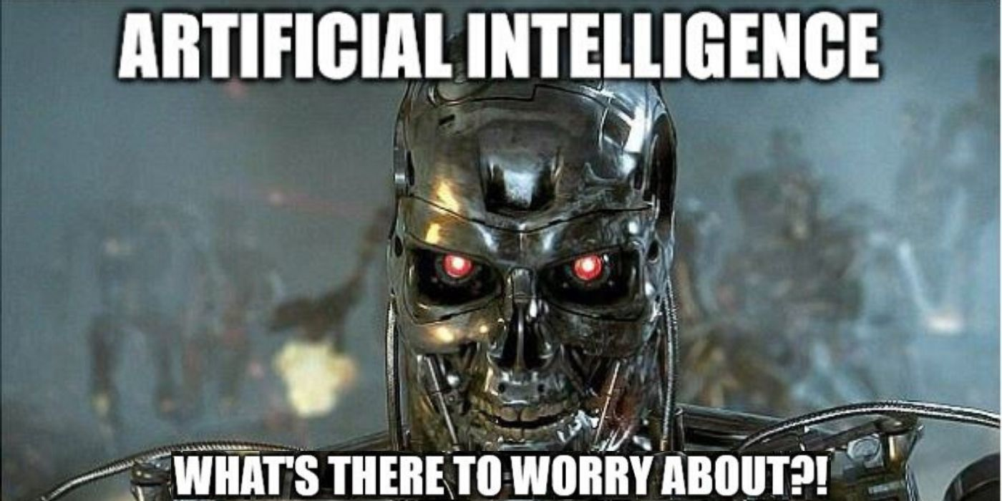

Slide 4
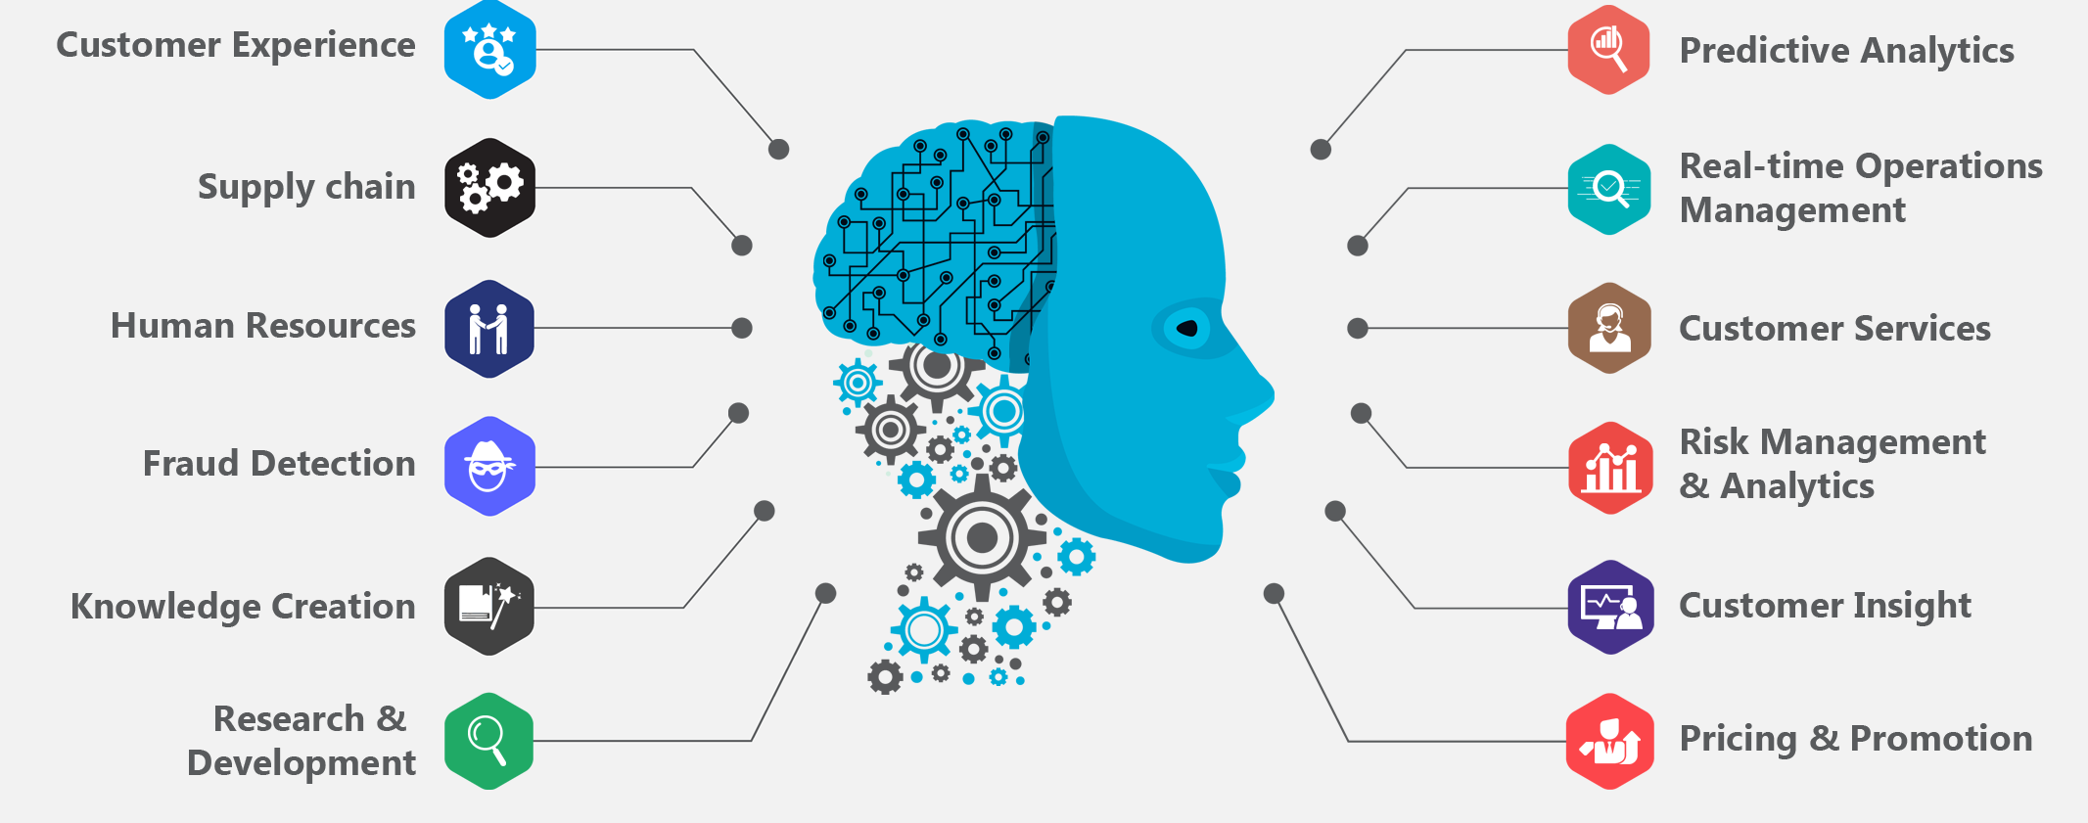
AI Scenarios

Slide 5
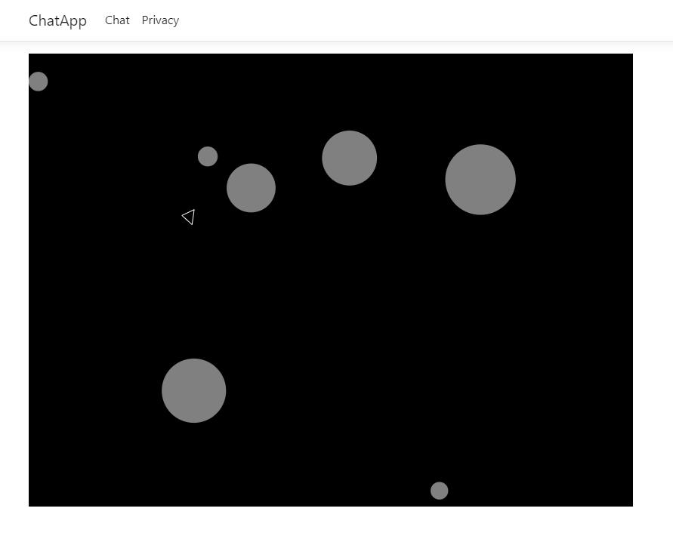
Let’s play a game

Slide 6
Chatting with LMM’s
- Large Language Models predict what comes next
- Prediction engine
- What can AI do for me?

Slide 7
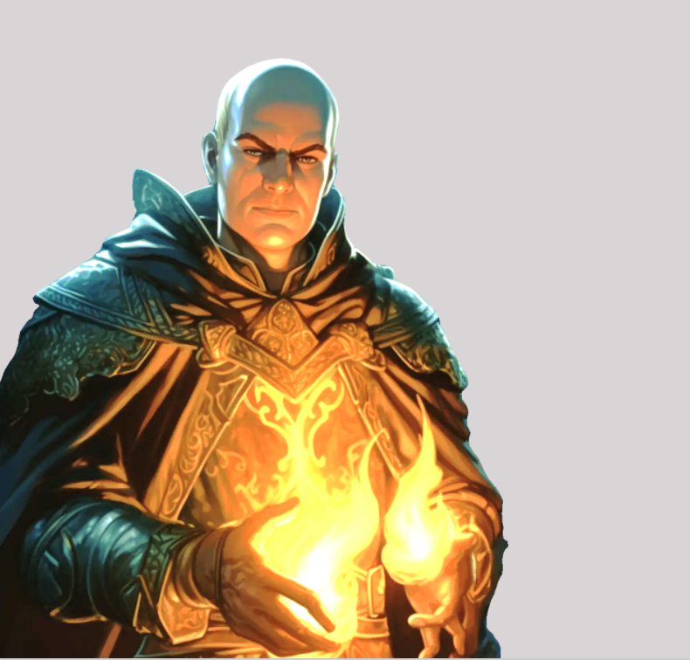
Prediction engine
What comes next?
What do I know about you?
How do I figure it out?

Slide 8
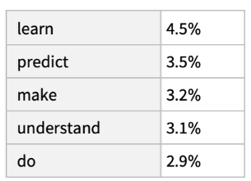
The best thing about AI is it’s ability to …

Slide 9
Prediction
The best thing about AI is its ability to,
The best thing about AI is its ability to learn,
The best thing about AI is its ability to learn from,
The best thing about AI is its ability to learn from experience,
The best thing about AI is its ability to learn from experience.,
The best thing about AI is its ability to learn from experience. It,
The best thing about AI is its ability to learn from experience. It’s,
The best thing about Ai is its ability to learn from experience. It’s not…

Slide 10
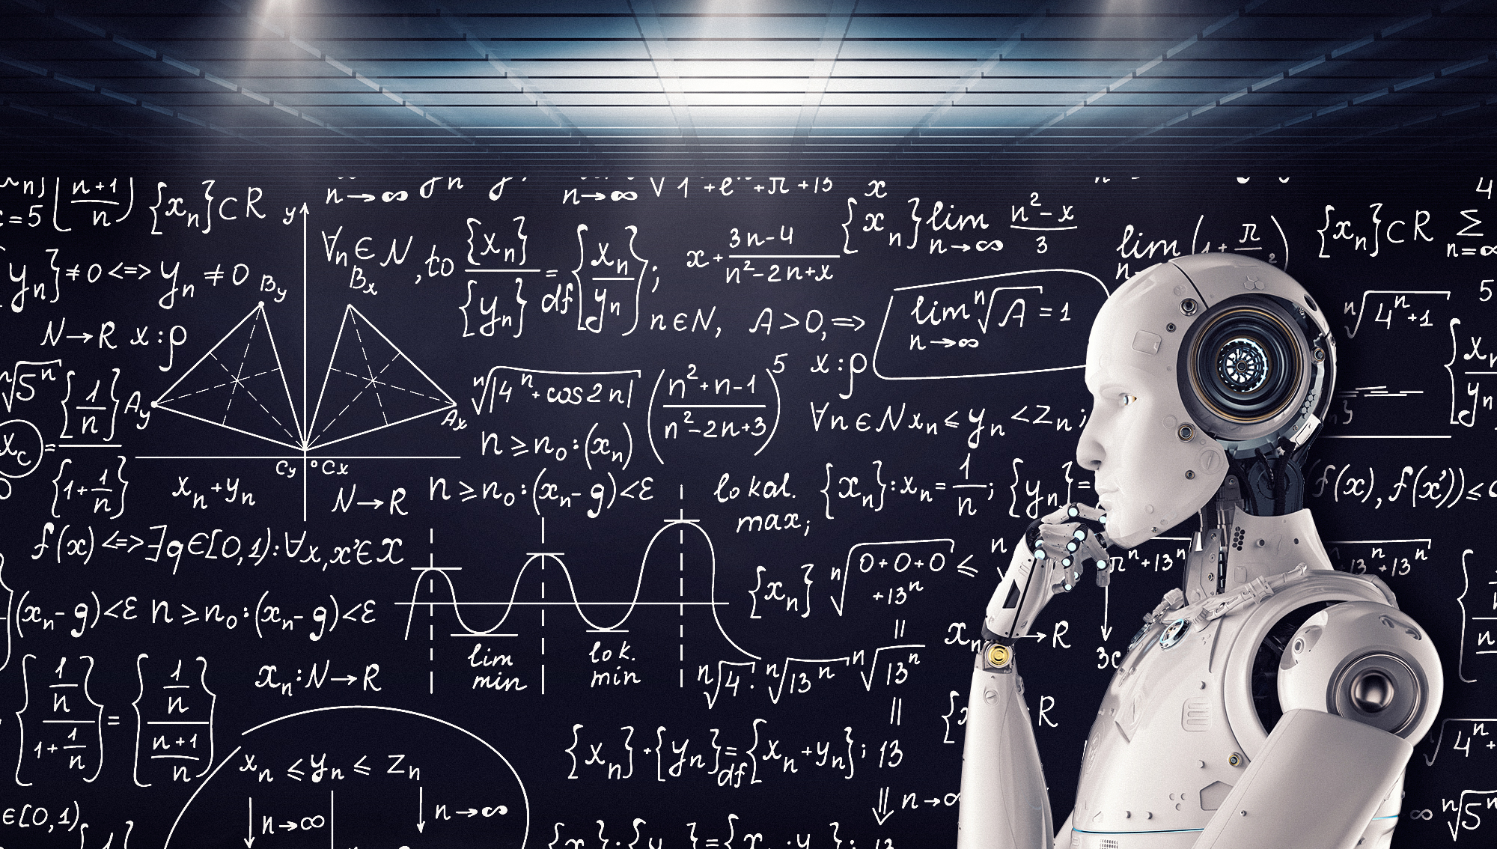
Built on Math

Slide 11
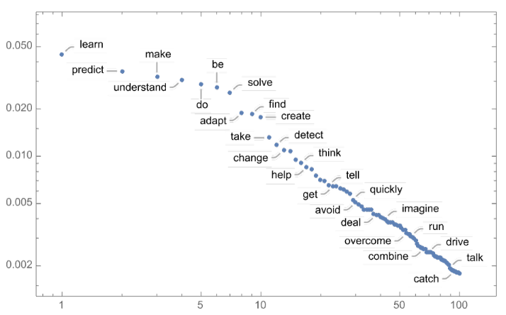
Power-law decay

Slide 12
Temperature
“The best thing about AI is its ability to learn from experience. It’s not just a matter of learning from experience, its learning from the world around you. The AI is very good example of this. It’s a very good example of how to use AI to improve your life. It’s a very good example of how to use AI to improve your life. The AI is a very good example of how to use AI to improve your life. It’s a very good example of how to use AI to…”

Slide 13
Lower the temperature…
The best thing about AI is its ability to learn. I’ve always liked the…
The best thing about AI is its ability to really come into your world and just…
The best thing about AI is its ability to examine human behavior and the way it…
The best thing about AI is its ability to do a great job of teaching us…
The best thing about AI is its ability to create real tasks, but you can…

Slide 14
Too low temperature?
“The best thing about AI is the ability to see through, and make sense of the world around us, rather than panicking and ignoring. This is known as AI “doing its job” or AI “run-of-the-mill” Indeed taking an infinite number of steps, developing a machine that can be integrated with other systems, or controlling one system that’s truly a machine, is one of the most fundamental processes of AI. Aside from the human-machine interaction, AI was also a big part of creativity…”

Slide 15
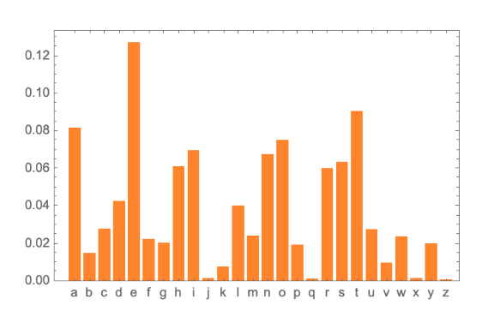
What comes next?

Slide 16
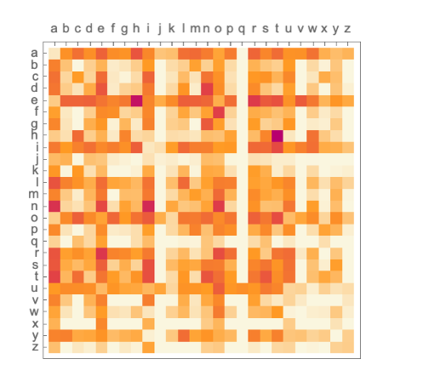
2-grams … i.e. pairs of letters

Slide 17
Prompts and Tokens
https://platform.openai.com/tokenizer
Vector Databases
RAG – Retrieval Augmented Pattern
Prompt Flow

Slide 18
GPTs (generative pre-trained transformer)
Provide text outputs in response to inputs
Code generation
Summarization
Conversation
Creative writing

Slide 19
Embeddings
A vector representation of a piece of data
Search
Clustering
Recommendations
Anomaly detection
Classifications

Slide 20
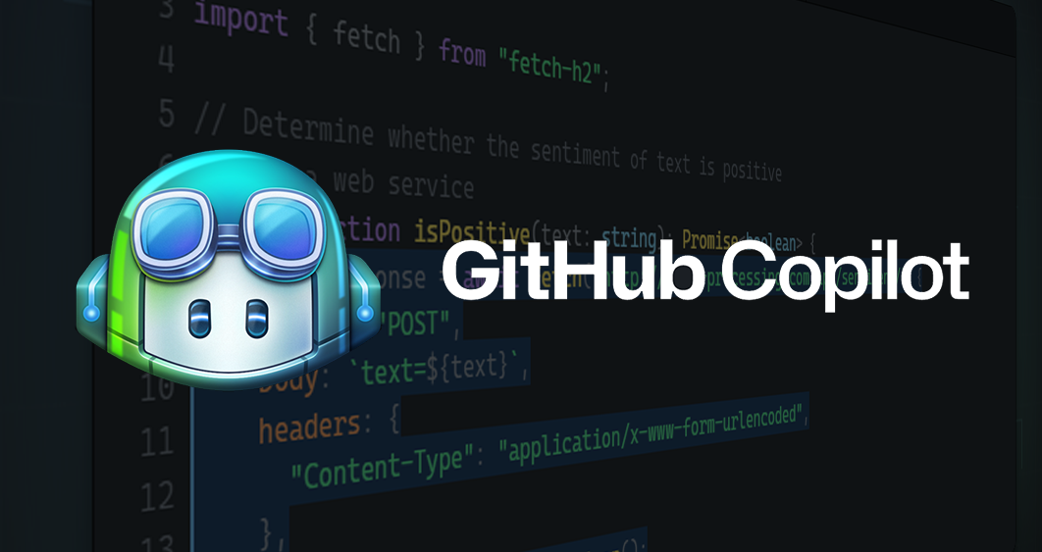

Slide 21
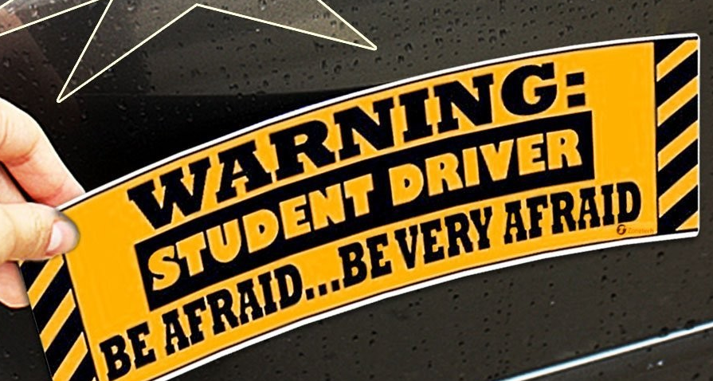
Copilot
How can I help?
Pay atterntion…

Slide 22

OpenAI Service

Slide 23
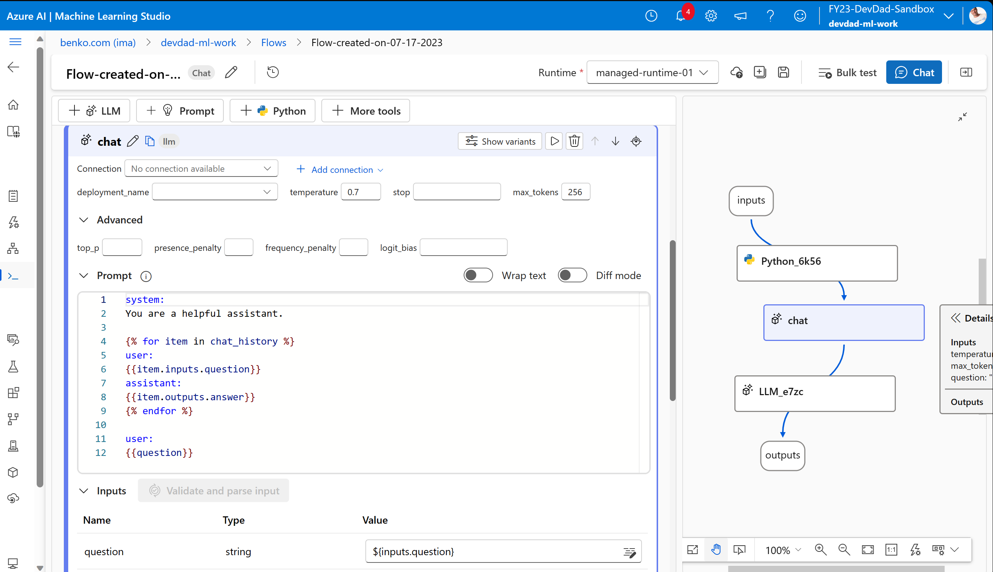
Promptflow

Slide 24
Lessons learned
Fear not…
Learn to ask better questions
Practice

Slide 25
References
What Is ChatGPT Doing … and Why Does It Work?—Stephen Wolfram Writings
Seth Juarez – Roshambo

Slide 26
